Slide 1



Professional Semiconductors Manufacturer
Shenzhen Hottech Electronics Co., Ltd.
2024 Version

Slide 2

CONTENTS
01
02
03
04
Company Profile
Main Products
Applications
Hottech Advantage

Slide 3

01
Company Profile

Slide 4

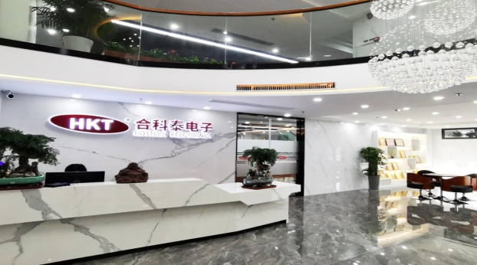
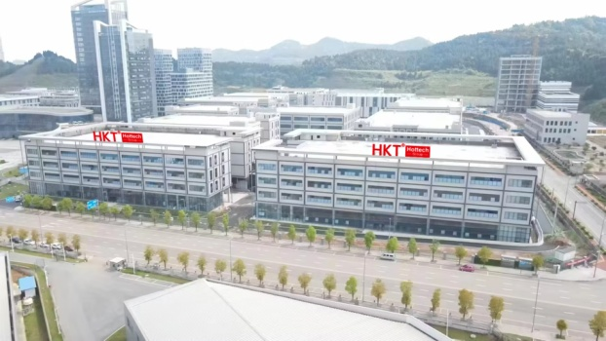

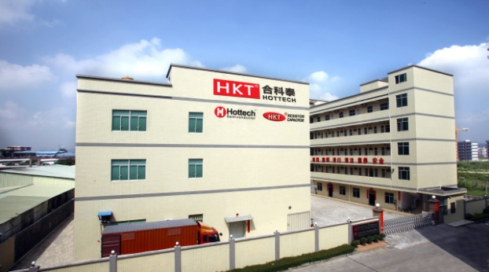
About Us
Founded in 1992, Hottech is a high-tech innovative enterprise specializing in the R&D, production and sales of semiconductor devices. The product line includes diodes, transistors, bridge rectifiers, MOSFET, power management ICs and other ICs, resistors, capacitors, copper frame, etc. We can provide customers with one-stop application solutions and on-site technical support services.
Hottech has three production bases, located in Dongguan, Nanchong and Huizhou. With adherence of independent innovation, Hottech is a comprehensive enterprise of packaging, testing and OEM of integrated circuits and semiconductor devices.
-- Three subsidiaries under construction in Sichuan Province,
1) Sichuan Shunxin Semiconductor Technology Co., Ltd. (mainly engaged in integrated circuit power devices);
2) Nanchong Anhao Electronics Co., Ltd. (mainly engaged in chip resistors);
3) Nanchong Jingke Precision Technology Co., Ltd. (mainly engaged in materials of semiconductors)
Hottech has rich core technologies experience in circuit&,semiconductor device design, reliability design, and device model extraction etc.,and has obtained multiple qualifications such as national invention patents and utility model patents.
The company has passed ISO9001, ISO14001, IATF16949 system certification. Products are widely used in power supply, lighting, medical electronics, household appliances, communication device, security, instruments, industrial control and other fields.
Marketing Center-Shenzhen
Manufacturing Center-Sichuan
Manufacturing Center-Huizhou
Manufacturing Center - Dongguan

Slide 5
History
Now & Future
In 2024, we started the construction of three branches in Sichuan:
1)Sichuan Shunxin Semiconductor Technology Co., Ltd. (mainly engaged in integrated circuit power devices);
2)Nanchong Anhao Electronics Co., Ltd. (mainly engaged in chip resistors);
3) Nanchong Jingke Precision Technology Co., Ltd. (mainly engaged in semiconductor materials).
Established
In 1992: Hottech started as a shop for selling
In 2000: Shenzhen Hottech Electronics Co., Ltd.
Years of growth
In 2018, Hottech Group's annual revenue exceeded 400 million RMB.
1992-2000
2001-2010
2011-2018
2019-2023
2024-
Development
In 2010, Hottech Group's annual revenue exceeded 100 million RMB.
Guangdong Hottech Industrial co., Ltd was established as production base.
Business Expanding
In 2023, Huizhou Hottech production base was under construction. Once completed, our annual output will reach 23 billion pcs per year. Till 2023, we’ve obtained more than 40 patents.

Slide 6

Company Structure
Chairman
General Manager
Management Representative
Manufacturing Center
Marketing Center
HR Center
R&D Center
Financial Center
Production Management Dept.
Purchase
Dept.
Sales Dept.
Logistic Dept.
R&D Dept.
Finance Dept.
Production Dept.
Quality Dept.
Marketing Dept.
Business Assistant
HR Dept.
Administration Dept.
Engineering Dept.
Risk Control Dept.

Slide 7
Technical Supports
Customization
Smart System
Products Development
Customized services Offer customized products and OEM services
Production management under smart system including ERP、MES、WMS、CRM information management
Annual R&D expenses In 2023, 5.6% of annual income; increasing 0.3% than 2022
Patents
Qualified Team
LT
Patents till 2024, over 40 patents
Core Team totally over 600 staff; focus on products’ quality and technical innovation
Quick Response over 10000 ㎡ warehouse to support short lead time

Slide 8
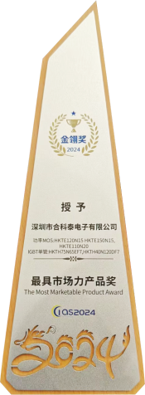
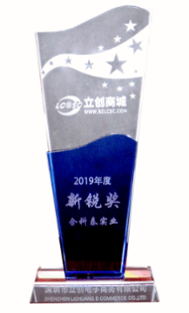
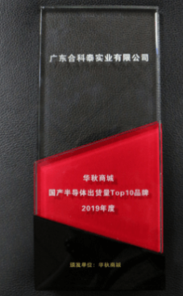
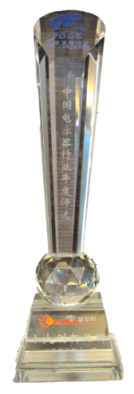


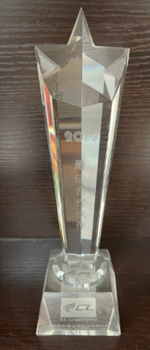
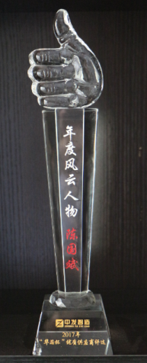
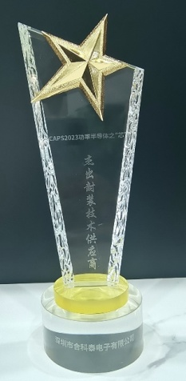
Honor
In 2008 year, ”Shenzhen Integrity and Contribution Enterprise” Award
In 2009 year , “China Best-Selling Brand” “China Famous Brand” Award
In 2011 year , “Outstanding Enterprise in Semiconductor Devices industry” Award
In 2012 year , “Top 10 National Brands in China Semiconductor Industry” Award
In 2014 year, “State Advance Technology Enterprise” Certificate
In 2015 year “Top 10 High-Tech Component Brands”Award
In 2016 year, “Pioneer Growing Company” Title
In 2017 Year“China Most Innovative Semiconductor Brand”Award
In 2019 year, Hottech Brand Value estimated more than 6.8 Billion
In 2022 year, Blue-Spot Award in Innovation and Outstanding Contribution
In 2024 year, Golden Award for Most Marketable Product in the Power Device
category and Quality Supplier category

Slide 9
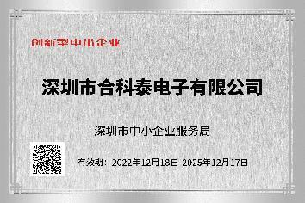

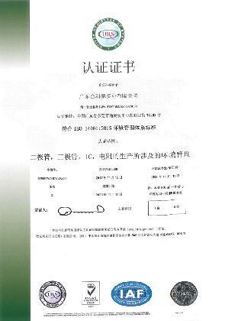
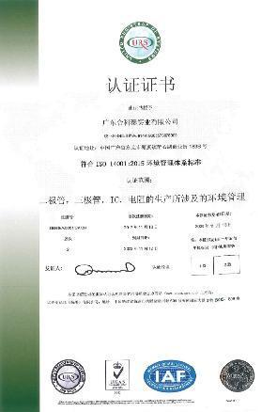
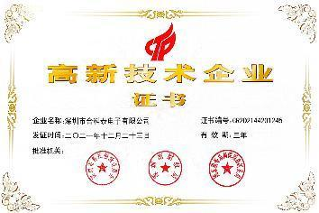
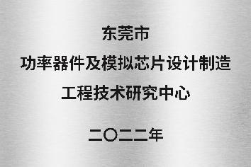
Certificates
Certificates of Advanced Technology Company Approved by Department of Science and Technology of Guangdong Province
（ISO9001:2015)
(ISO14001:2015)

Slide 10
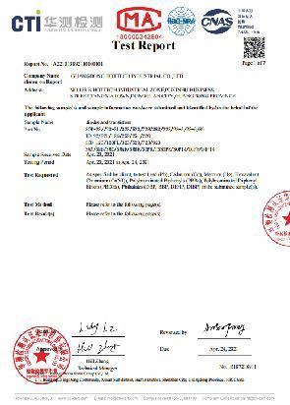
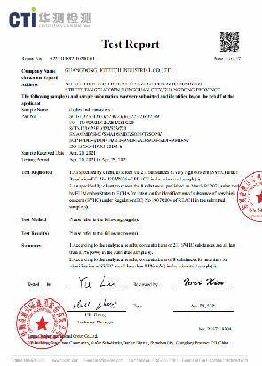
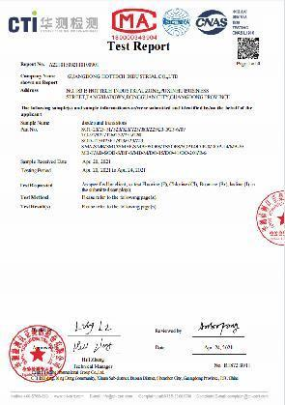
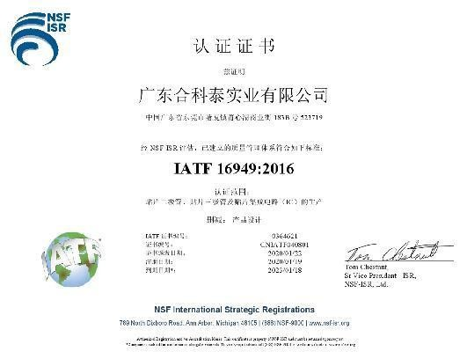
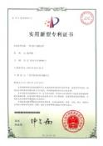
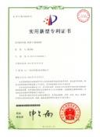
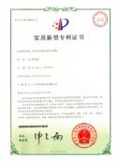
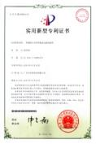
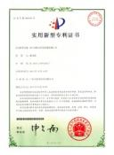
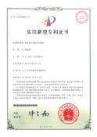
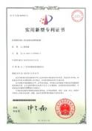
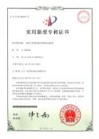
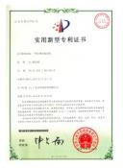
Certificates & Patents
（ IATF 16949 ）
（RoHS）
（REACH）
（ Halogen-free Report ）
Patents

Slide 11
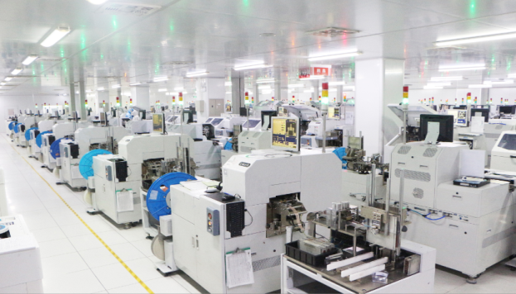
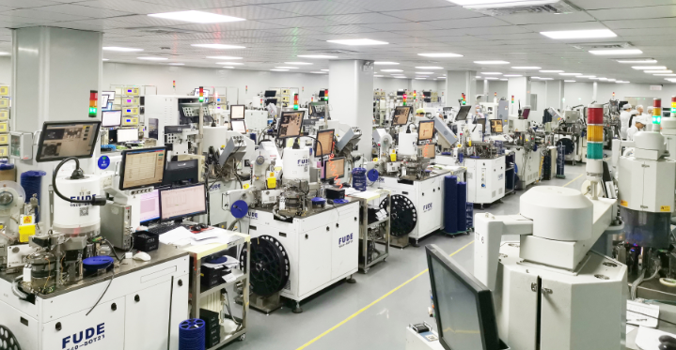
Original Manufacturer
Nanchong Manufacturing Center in Sichuan -- base of ICs, power devices, chip resistors, and semiconductor materials
Huizhou Manufacturing Center in Guangdong ( 8000㎡) -- will be put into use in the end of 2024 with annual output of 7 billion pcs.
Dongguan Manufacturing Center in Guangdong ( 15000㎡)
-- mainly engages in packaging, testing, and OEM of integrated circuits and semiconductor devices with annual output of 18 billion pcs till 2024. The factory has about 1000 set of production equipments with advanced laboratories.
Workshop
Manufacturing Center-Sichuan
Manufacturing Center -Huizhou
Manufacturing Center -Dongguan

Slide 12
Production capacity
In 2024，With two production bases，The production capacity will reach 25 billion pieces/year.

Slide 13
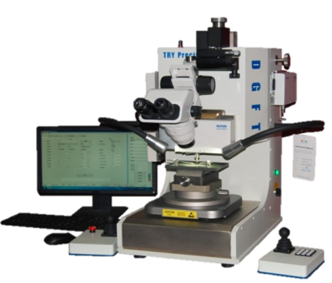
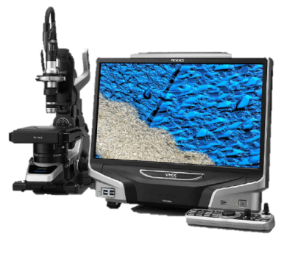
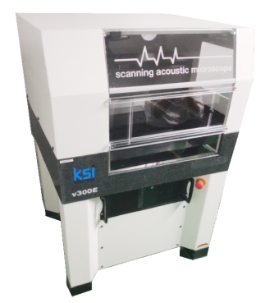
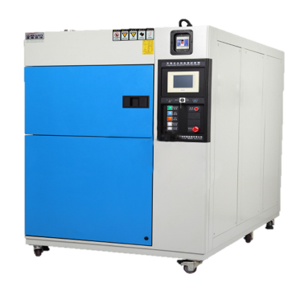
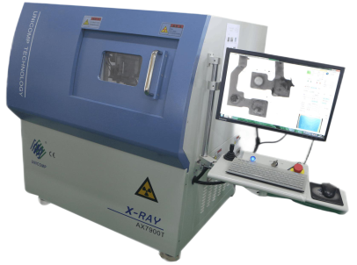
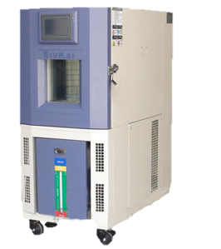
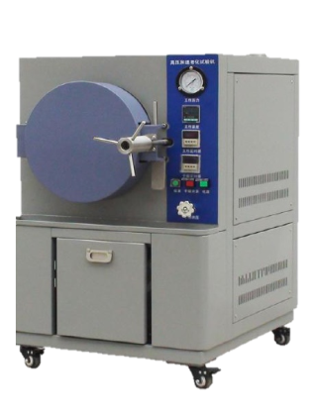
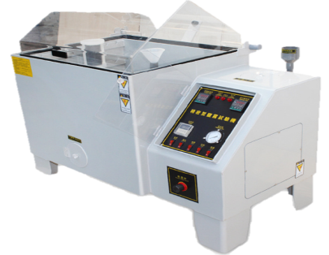
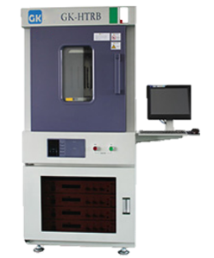
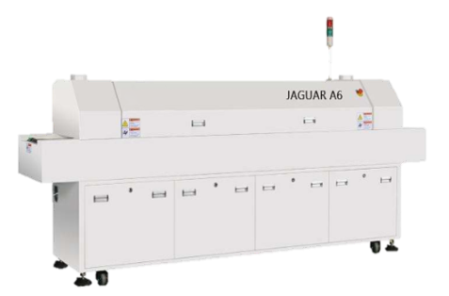
Testing capability
Die shear& Wire pull
（Wafer cutting & Weld wire tension test）
Microscope
（Arc of line, ball diameter and thickness testing）
X-RAY
（ Welding wire opening and short circuit test）
Sonoscan
KSI High Resolution Acoustic Microscope System
（Acoustic stratified scanning test）
TCT
Cooling and heating temperature control system
（Temperature cycling testing）
BR Salt spray test machine
（Environmental tests for corrosion resistance of products or metallic materials）
HTRB
（High temperature reverse bias testing
）
HT&HU
Constant temperature/humidity testing
HTST&PCT
High temperature and pressure testing machine
Reflow soldering test machine

Slide 14
Testing capability
Test performed | Test condition | Readout | S.S | A/R | Reference Std.(JEDEC)
High temperature storage test | TA =200°C Duration =168 Hrs/1000Hrs | 0Hrs 168Hrs 1000 Hrs | 77 | 0/1 | JESD22-A103D
High temperature reverse bias | TA =150°C，Vbias =80% DC Duration =168 Hrs/1000Hrs | 0Hrs 168Hrs 1000 Hrs | 77 | 0/1 | JESD22A-108D
Constant temperature/humidity | TA =85°C,RH=85% Duration =168 Hrs/1000Hrs | 0Hrs 168Hrs 1000 Hrs | 77 | 0/1 | JESD22-A101C
Soldering heat resistance | 260±5°C,10±1Secs Duration =1 Cycle | 0Cycle 1Cycle | 77 | 0/1 | JESD22-B106C
Solder ability test | 260±5°C, 5±1Secs Duration =1 Cycle 95% coberage minimum | 0Cycle 1Cycle | 10 | 0/1 | JESD22-B102D
Temperature shock | 0℃,5minute； 100℃,5minutes；10cycle | 0Cycle 10Cycle | 77 | 0/1 | JESD22-A106B
Temperature cycle | TL=-40℃,30minute；+25℃,15minutes； TH=+150℃,30minute；+25℃,15minutes；10cycle | 0Hrs 168Hrs 1000 Hrs | 77 | 0/1 | JESD22-A104D
High temperature and pressure cooking | Pressure=2.05*105PaTa=121℃,RH=100% | 0Hrs 24Hrs 96 Hrs | 77 | 0/1 | JESD22-A102-C
High temperature and pressure reverse bias | Ta=85°C, 85%RH 80% rated VR up to 100V + DPA Duration =168 Hrs/1000Hrs | 0Hrs 168Hrs 1000 Hrs | 77 | 0/1 | JESD22-A101

Slide 15
Quality management system
Hottech establishes & implements a standardized Quality Management System in accordance with ISO9001 , ISO14001 and IATF16949 to guarantee good quality in all aspects. All operators must strictly follow the workshop instructions in each production process, and all workshops have professional technician teams to control the product quality. Only qualified products can enter the warehouse for shipment. All products are under 100% full inspection by testing machines to ensure that the end customers get good quality guarantee in their application.
QC inspection
QC inspection
QC inspection
QC inspection
Wafer inspection
Marking
Storage
Shipments
Cutting
Fixed
Wire
Plastic seal
Wafer
Wafer processing
Visual inspection
Epoxy resin
Batch sampling
Lead frame
Copper
Electronic
properties
Silver Colloid
Wafer
appearance
Cutting depth
of pure water
resistivity
Chip
appearance
Temperature
Exterior
Exterior
Name,
quantity

Slide 16

02
Main Products

Slide 17
Contents
Contents
MOSFET
Bridge Rectifier
Diode
Transistor
TVS & Zener
Ics & others
01
02
03
04
05
06

Slide 18
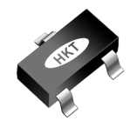
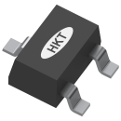
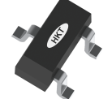
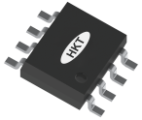
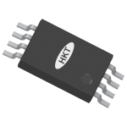

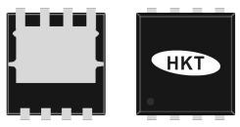
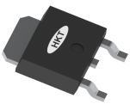
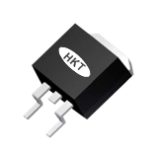
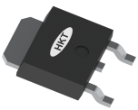
Mosfet
产品类型 | 封装图片 | Main PNs | Applications
MV & LV MOSFET | SOT-523 SOT-323 SOT-23 | 2N7002KT 2SK3018W，BSS138W 2N7002K，AO34xx，SI23xx | Electric tools、Smart speaker、Mobile power supply、Massager、hand warmers、network set-top box、Surveillance cameras、Smart lock、monitor、Household appliances、Car DVR
 | SOP-8 TSSOP-8 | AO43xx，AO46xx(N+P) AO9926A，AO48xx(N+N,P+P) FL8205，AO88xx(N+N,P+P) | Electric tools, Electric toothbrush, Electronic cigarettes, Smart speakers, Mobile power supplies, Massagers, Car DVR, Hand warmers, Household appliances
 | PDFN3*3 PDFN5*6 | HKTQ60N02，HKTQ30N03，HKTQ65N03，HKTQ80N03，HKTQ150N03，HKTQ40N40，HKTQ30P03，HKTQ2317，HKTG50N03，HKTG90N03，HKTG150N03，HKTG120N04，HKTG48N10，HKTG40C40 | Electric tools, electric bicycles, PD fast charger, wireless charger, smart sockets, mobile power supplies, Battery protection boards, Electronic cigarettes, Sweeping robots
 | TO-252 TO-263 | HKTD50N03，HKTD80N03，HKTD70N04，HKTD120N04，HKTD20N06，HKTD80N06，HKTD15N10，HKTD5N20，HKTE180N08，HKTE100N10，HKTE120N10，HKTE130N12，HKTE120N15，HKTE110N20 | Electric tools, electric bicycles, PD fast charging, smart sockets, Switching Mode Power Supplies, Inverters, Battery protection boards, Household appliances, Sweeping robots
HV MOSFET | TO-252 | HKTD4N50，HKTD5N50，HKTD2N60，HKTD4N65，HKTD7N65 | Switching Mode Power Supplies、LED driver power supplies，Household appliances, Sweeping robots

Slide 19
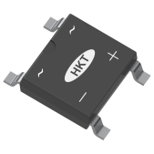







Bridge Rectifier
Products | Packages | Main PNs | Applications
SMD Bridge | ABS MBS DBS | ABS10，ABS210 MBxS、MB2xS、 DB10xS、DB20xS、DB30xS | PD fast charger、Smart socket、Adapter、Smart lighting、Household appliances,etc.
DIP Bridge | GBP GBU GBJ | GBP2x, GBU4x,GBU35x GBJ10x,GBJ50x | PD fast charger、Electric bike charger、Switching Mode Power Supply、Household appliances、Charging pile
DIP Bridge | KBPC GBPC | GBPC25x、GBPC35x、 KBPC15x、GBPC25x | Electric bike charger、Switching Mode Power Supply、Household appliances、Charging pile

Slide 20











Diode
Products | Packages | Main PNs | Applications
Schottky diode Switching diode Rectifier diode | SOD-523 SOD-323 SOT-23 | 1N4148，SD103AX，B5819LWT，BAV21WS，SD103AWS，1N5819WS，MBR0520LS，BAS21，BAV23，BAV70，BAV99，1SS181，BAT54，BAS40，BAS70 | PD fast charger、Electric toothbrush、Smart speaker、Massager、network set-top box、Surveillance cameras、Car DVR、Smart lock
 | SOD-123 SOD-123FL | 1N4148W，1N4448W，1N5819W，SD103CW，SS1x，SS2x，SS3x，MBR0520L，1N4148WL，1N4007L，FR107L，SS1xL，SS2xL | PD fast charger、Smart socket、Switching Mode Power Supply、Smart lighting、Electric tools、inverter、Massager、network set-top box、Surveillance cameras、Car DVR、sweeping robot、Smart lock、monitor
 | SMA SMB SMC | M7，RS1M，US1M，ES1J，SS1x，SS2x，SS3x，S1MB，RS2M，US2M，ES2J，SS2xB，SS3xB，S3M，S5M，RS3M，US3M，SS3xC，SS5xC
 | SMAF SMBF TO-252 | M7F，S3MF，RS1MF，US2MF，ES2MF，SS1xF，S1MBF，US3MBF，ES1JBF，SS2xBF，SS5xBF，MBRD20100CT，MBRD20150CT

Slide 21






Transistor
Products | Packages | Main PNs | Applications
Transistor | SOT-323 SOT-23 | 2SC3356，2SC3357，2SC4083，S9014W， MMBT5551，MMBT5401，MMST2222A， S8050，S8550，MMBT3904，MMBT3906， BC846，BC847，BC856，BC857 | Electric tools、Smart speaker、Mobile power supply、Massager、hand warmers、network set-top box、Surveillance cameras、Smart lock、monitor、Household appliances、Car DVR
 | SOT-89 SOT-223 | D882，B772，BCX53，BCX56，A42，A92，2SA1013，2SC2383，BCP54，BCP56，PZT2907A，PZT4403 | Household appliances、Microinverter、Atomizer、Fascia Gun、Electronic toy
 | TO-252 TO-220 | D882，MJD122 | Inverter，Energy storage

Slide 22







TVS & Zener
Products | Packages | Main PNs | Applications
TVS And Zener diode | SMA SMB SMC | SMAJxxxA(UNI)，SMAJxxxCA(Bi）SMBJxxxA(UNI)，SMBJxxxCA(Bi) SMCJxxxA(UNI)，SMCJxxxCA(Bi ) | Electric tools、Smart speaker、Mobile power supply、Massager、hand warmers、network set-top box、Surveillance cameras、Smart lock、monitor、Household appliances、Car DVR
 | SOD-123 SOD-123FL | BZT52Cxx series，MM1Z xx series， MM1Z xxLs eries | Household appliances、Electric tools、Smart water meter、network set-top box、PD fast charger、Smart socket、Adapter、Smart lighting、Smart lock
 | SOD-323 SOT-23 SOT-323 | BZT52CxxS series，BZX84Cxx series，BZX84CxxW series | Household appliances、Electric tools、Smart water meter、network set-top box、PD fast charger、Smart socket、Adapter、Smart lighting、Smart lock

Slide 23






ICs & others
Products | Packages | Main PNs | Applications
ICs And Others |  | HKT4054，HKT4056，DW01，1117 series 6206 series，HT75 series，HT73 series，HT71 series，6219 series，78L series，78M series，78 series，79L series，79M series，79 series，TL431，TL432 | Electric tools、Smart speaker、Mobile power supply、Massager、hand warmers、network set-top box、Surveillance cameras、Smart lock、monitor、Household appliances、Car DVR
SOT23-5
ESOP8
SOT23-6
SOT-223
SOT-89
SOT-252

Slide 24






Resistor & Capacitor
Products | Packages | Main PNs | Applications
Chip Resistor |  | 1005，1006，0603，1206，1812，2512，0201，0402，0805，1210，2010
Chip Capacitor |  | 0201，0603，1206，1812，2225，0402，0805，1210，2010，2515 | Household appliances, Electric tools, Smart meters, Network set-top box, PD fast charger, Smart socket, Adapter, Smart lighting, Smart lock
Tantalum |  | A（3216），B（3528），C（6032）， D（7343），E（7343H）
Household appliances, Electric tools, Smart meters, Network set-top box, PD fast charger, Smart socket, Adapter, Smart lighting, Smart lock.
Household appliances, Electric tools, Smart meters, Network set-top box, PD fast charger, Smart socket, Adapter, Smart lighting, Smart lock.

Slide 25

03
Application

Slide 26
























Application
Power supply | Lighting | Medical Electronics | Home appliance | Communication | Security | Instrument and meter | Industrial Control
PD fast charger Charger Adapter DC power Charging pile Inverter | Spot light Canister light Ceiling light Desk light Street light | Health measuring instrument Therapy instrument Oxygen machine Blood pressure monitor | Cooker, microwave oven Washing machine Speaker Refrigerator TV Air conditioning | 5G base station Router Switch Phone Walkie-talkie | Surveillance camera Smoke alarm Temperature sensing alarm Emergency light | Multimeter Oscilloscope Thermal imager Electronic load Driving recorder | EPS/UPS Energy storage station Data center Electric tool Drone & AI

Slide 27

























Partners

Slide 28
03
Hottech Advantages

Slide 29





Advantages
Original Manufacturer
QC Management
Short LT
Technical Supports
One-Stop services
For More...

Slide 30
Q&A
1、Business opportunities？
2、Product ranges？
3、...

Slide 31

Tel
Fax
E-mail
Web
Add
：+86-755-82565333
：+86-755-82812433
：hkt@heketai.com
：www.hottechsemi.com
：No. 803, building 7, Kangli City, No. 66, Pingji Avenue, Longgang District, Shenzhen
Thank you

